Slide 1

Comparative Analysis of N-gram based, Machine Learning and Deep Learning Models for BI-RADS Classification from Mammography Reports
An Experimental Study on Portuguese Radiology Reports

Slide 2
Problem Statement
To classify mammography reports into BI-RADS categories (0–6) using only textual findings.
Compare traditional N-gram based Machine Learning models with sequential Deep Learning models (RNN & LSTM).
Evaluate performance under class imbalance.

Slide 3
Research Objectives
Apply N-gram + TF-IDF feature engineering for text classification
Train and evaluate traditional Machine Learning models
Implement and evaluate RNN, LSTM, and Bidirectional LSTM models
Compare all models using Macro F1 score
Perform error analysis and efficiency comparison

Slide 4
Overall Workflow

Slide 5
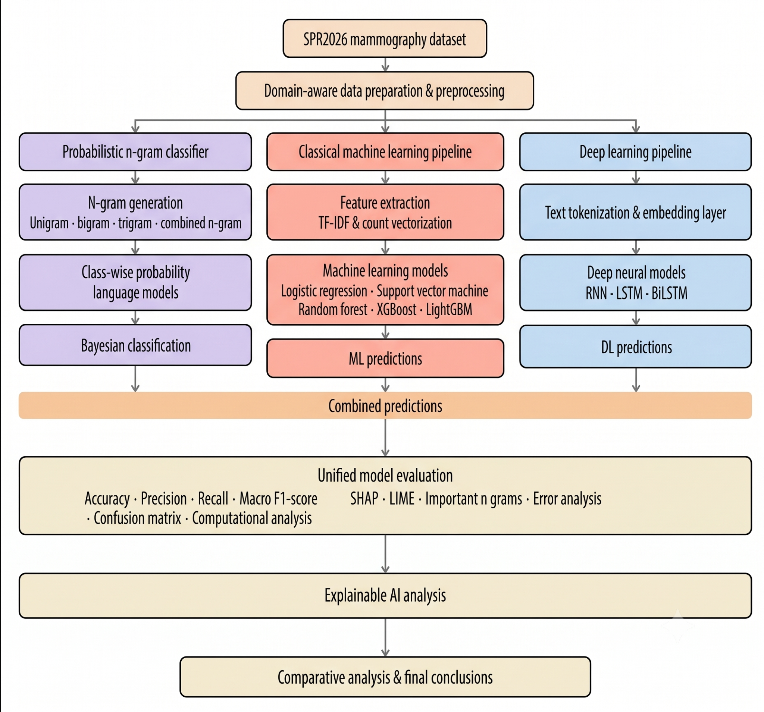

Slide 6
Dataset Description
Dataset: SPR 2026 Mammography Report Classification
Language: Portuguese
Columns: Report text + BI-RADS target (0–6)
Challenge: Highly imbalanced classes (BI-RADS 2 is majority)

Slide 7
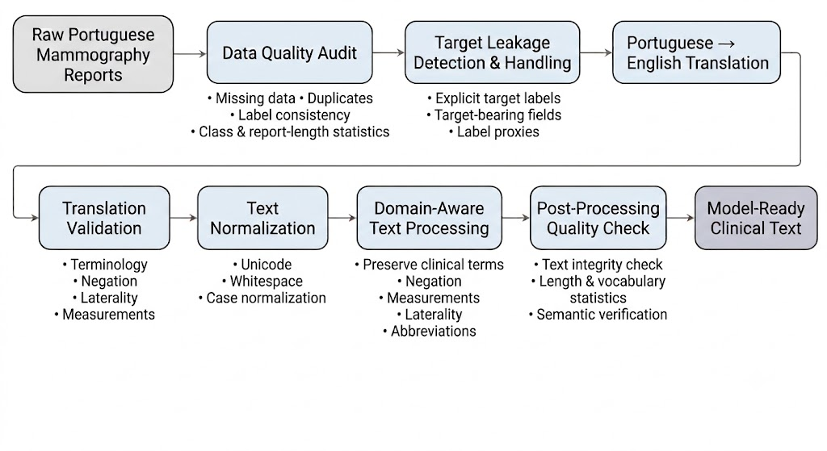
Data Preprocessing

Slide 8
N-gram Language Model Classifier

Slide 9
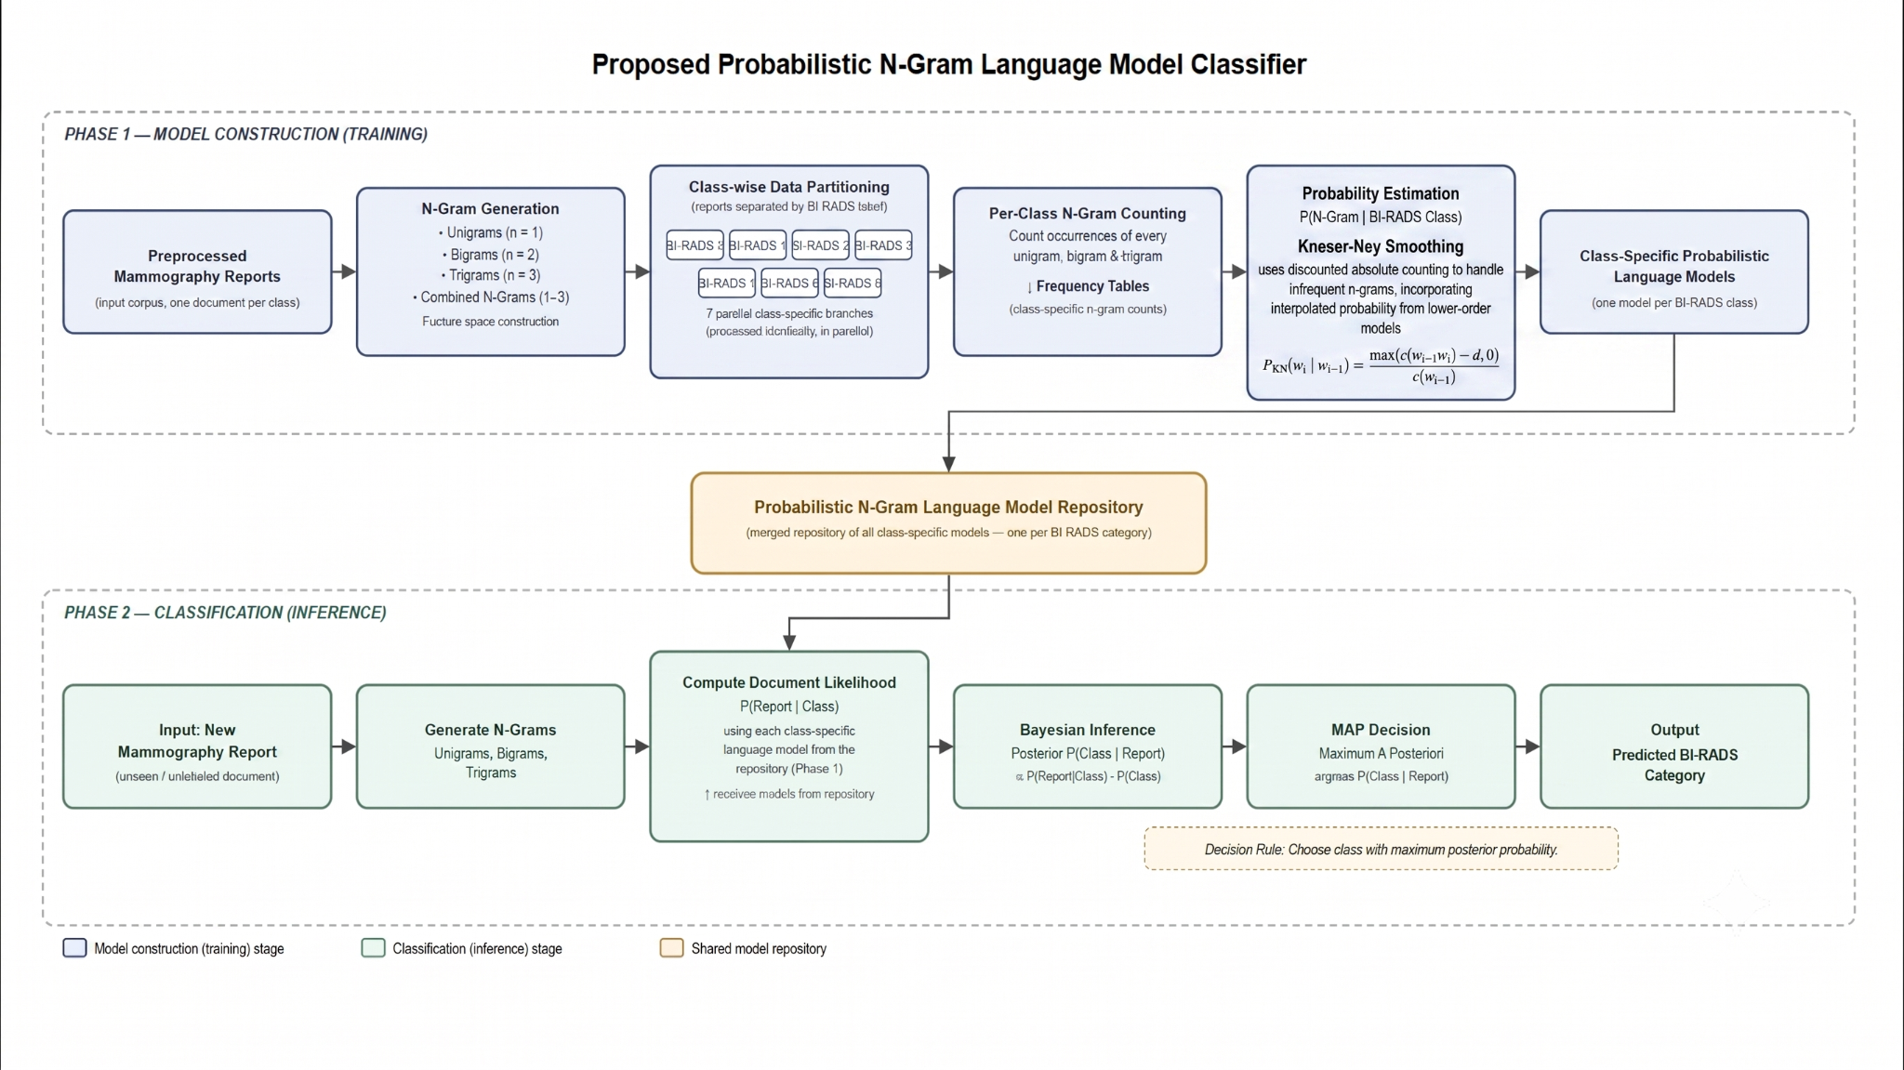

Slide 10
Current Pipeline

Slide 11
Data Processing & Model Development Pipeline
Data Acquisition
SPR2026 Mammography Report Classification dataset
Clinical reports + BI-RADS labels (0–6)
Data quality analysis (missing values, duplicates, class distribution)
Preprocessing
Remove target leakage (BI-RADS mentions)
Translate Portuguese to English
Normalize text and preserve medical terminology
Quality checks to produce model-ready text
Data Splitting
Stratified 80:20 train-test split
5-fold Cross Validation for tuning

Slide 12
Model Development (Subject to Refinement)
Three parallel approaches:
Probabilistic N-gram Model
Unigram, Bigram, Trigram
Kneser-Ney smoothing
Machine Learning
TF-IDF features
Naive Bayes, Logistic Regression, SVM, Random Forest, XGBoost, LightGBM
Deep Learning
Word Embeddings
RNN, LSTM, BiLSTM, GRU, LSTM + Attention
Prediction Aggregation
Compare outputs from all models

Slide 13
Evaluation & Comparative Analysis
Performance Evaluation
Macro F1 Score, Accuracy, Precision, Recall, Confusion Matrix, Per-class BI-RADS analysis
Explainability
SHAP & LIME
Important clinical keywords and n-grams
Misclassification analysis
Efficiency Analysis
Final Comparison
Compare N-gram, ML, and DL models
Accuracy vs Interpretability vs Efficiency
Recommend the best model for clinical deployment

Slide 14

Thank you!

